Slide 1
Hardware-accelerated QAOA for graph cutting
Better graph cuts than last time
Caffeinated Qrackheads

Slide 2
It is Friday evening…
you crave pizza…
you order your favorite…

Slide 3
But then minutes go by…
minutes turn to hours…

Slide 4
What happened?

Slide 5
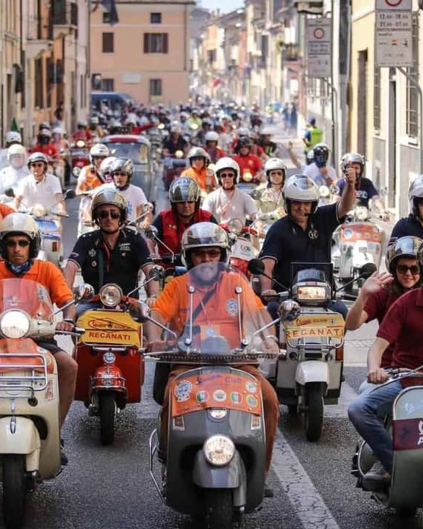
The delivery drivers all drove to the same city district!

Slide 6
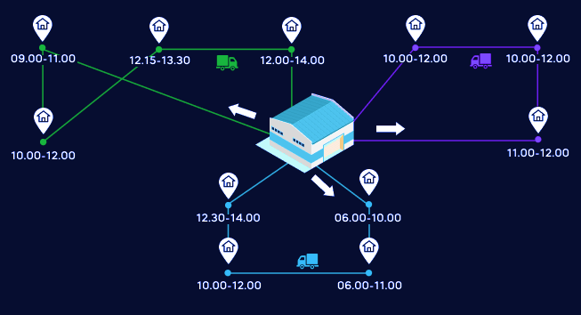

The Vehicle Routing Problem (VRP)
So that the pizza arrives on time…
TSP: optimal route to visit all customers
VRP: optimal set of routes to visit all customers with fleet
Example of the TSP & VRP

Slide 7
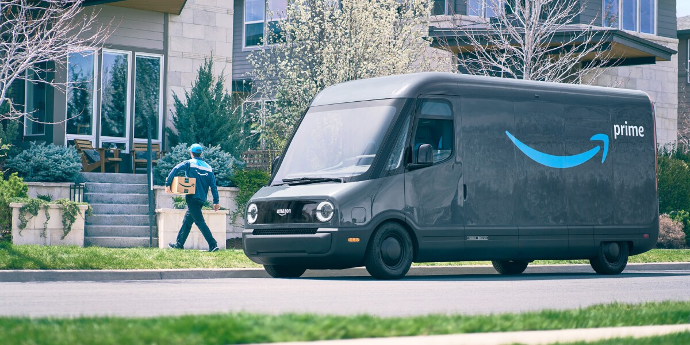
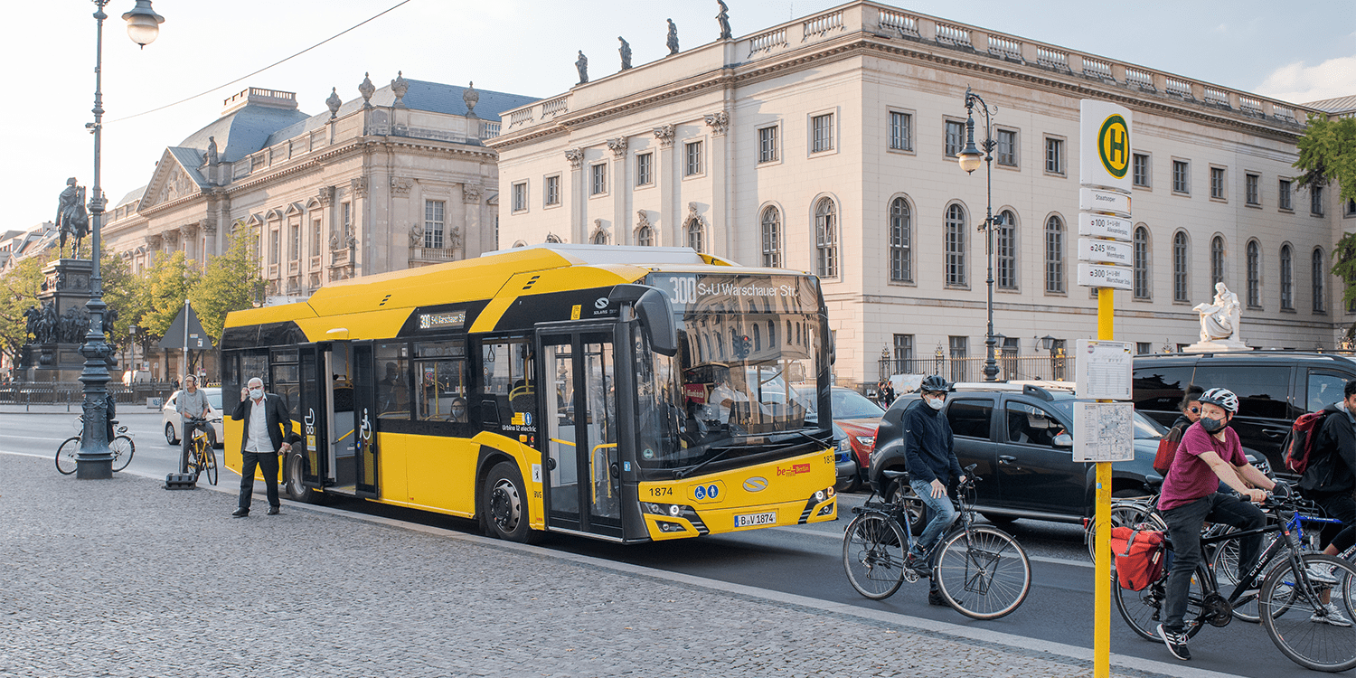
The Vehicle Routing Problem (VRP)
Where else can we use it?
Delivery services
Public transport
Waste collection
Emergency services
Agriculture

Slide 8
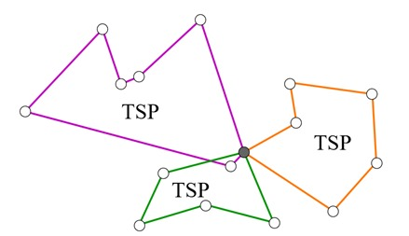
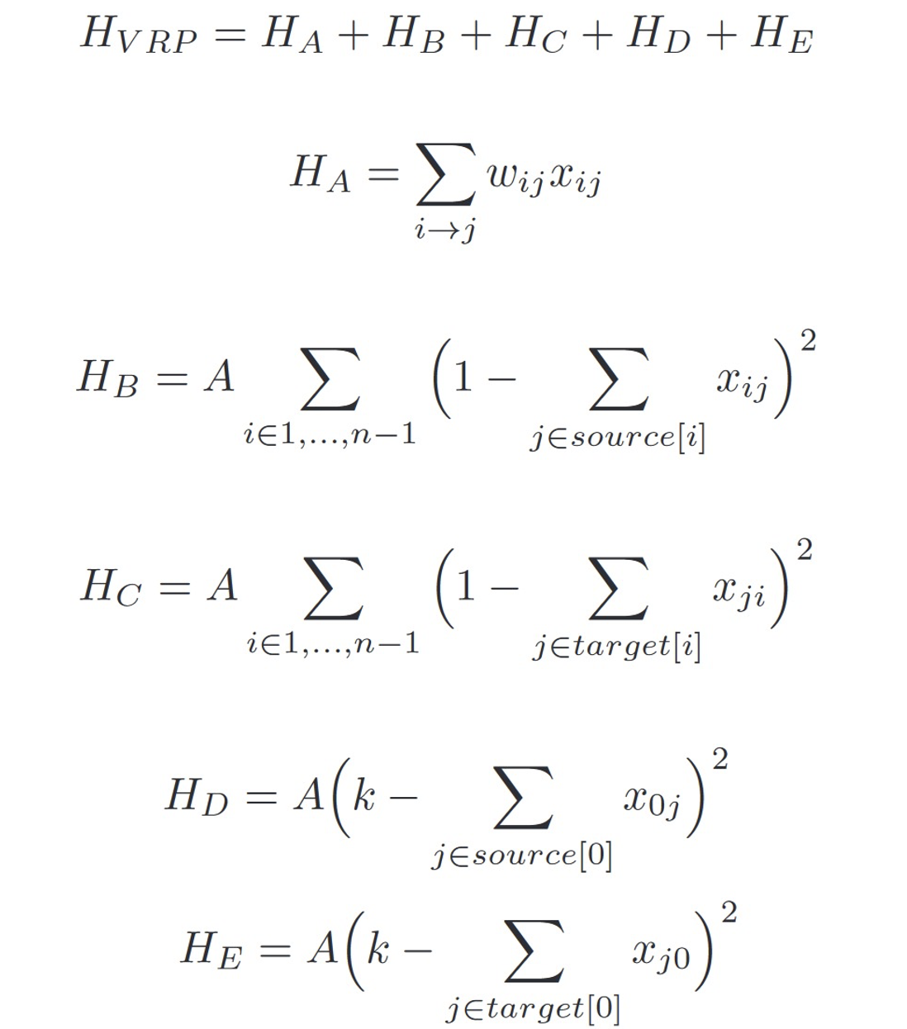
Can we translate this?
And why is the math so hard?!
QUBO
The math gets really difficult…

Slide 9
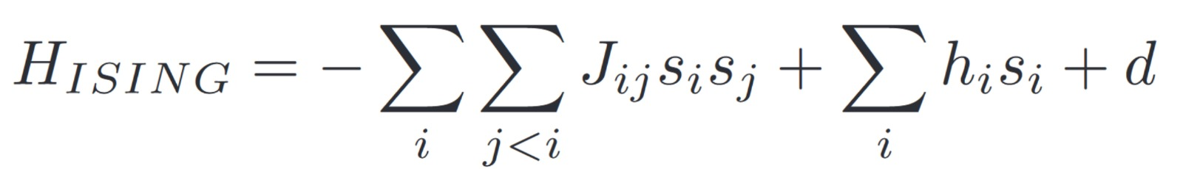
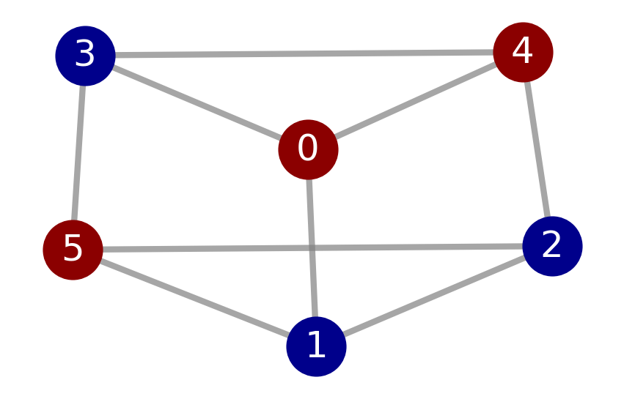
Can we translate this?
And QUBO is really nice!
Represent as MaxCut problem
Ising Hamiltonian
Use QAOA to find ground state
Key idea: Map each node in a graph to a qubit!

Slide 10
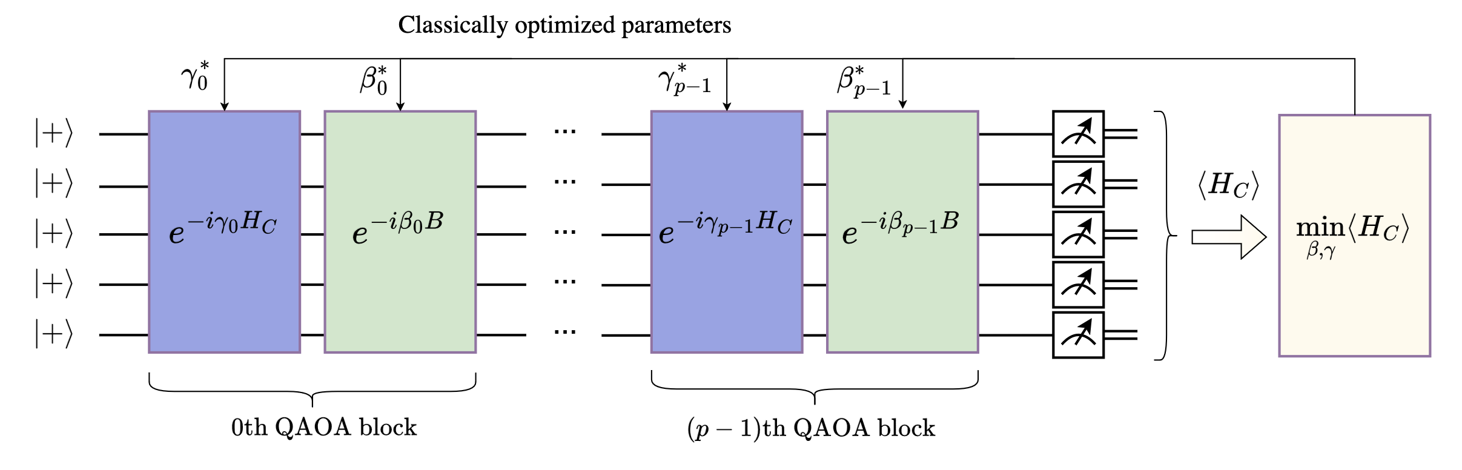
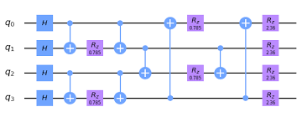
What is QAOA?
And what is the circuit?
2 parameters per layer
p layers
Ayse Kotil: Quantum Algorithms for Multi-Objective
Optimization

Slide 11
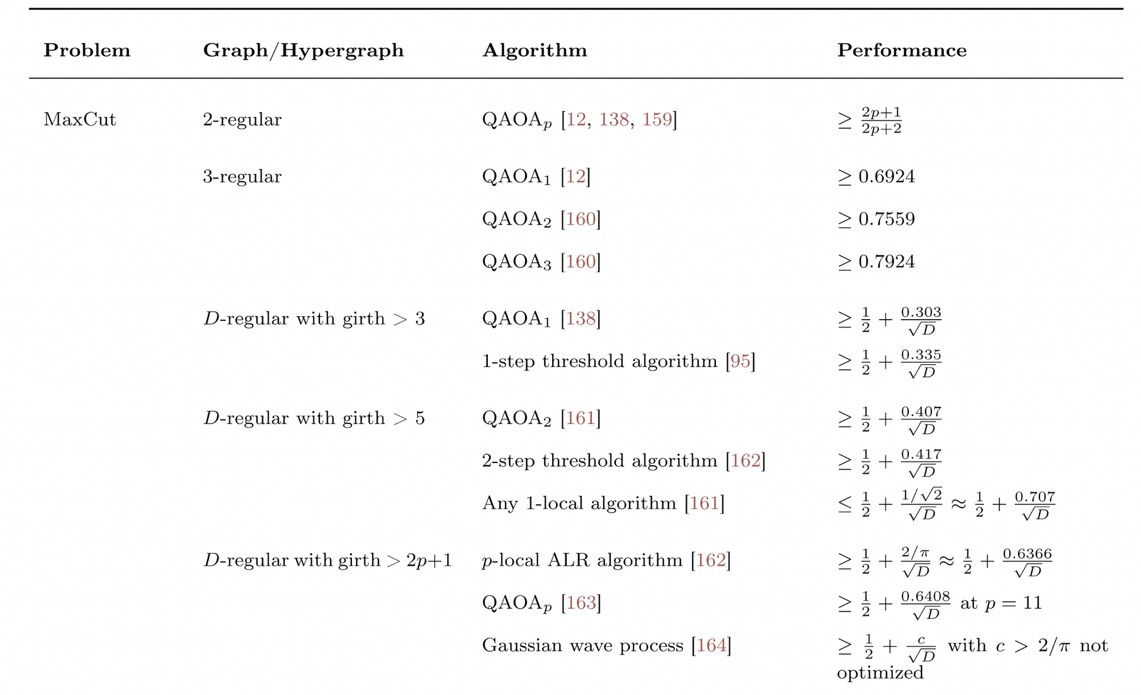
What to analyze with QAOA?
2-layer QAOA for 3-regular graphs!
arXiv:2306.09198

Slide 12
But what is a 3-regular graph?
And why do we need it?
Each node has 3 connections
Cubic graph
3-regular graph with 6 nodes

Slide 13

Can we cut a graph?
Knifes out
Define cut weight $CW=\#edges cut$
Here: $CW=7$
3-regular graph with 6 nodes and highlighted MaxCut

Slide 14
Results
QAOA ⇒ Quantum Computers
But today’s quantum hardware is noisy!
⇒ Simulations!
Allows: testing and refining of algorithms

Slide 15
QAOA for MaxCut
SETUP:
Generate random 3-reg graphs for varying sizes (nodes)

Slide 16
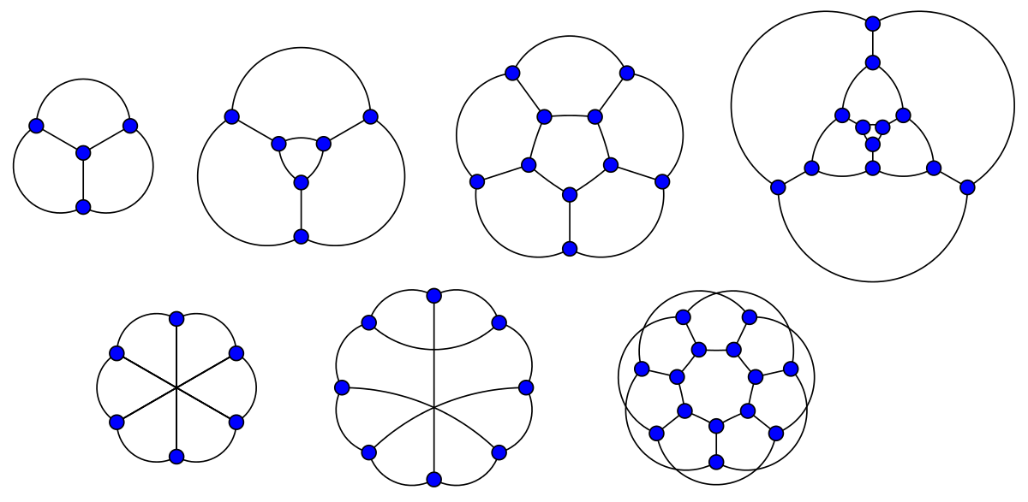
QAOA for MaxCut
SETUP:
Generate random 3-reg graphs for varying sizes (nodes)

Slide 17
QAOA for MaxCut
SETUP:
Generate random 3-reg graphs for varying sizes (nodes)
Gurobi -> Optimal Cut Weight

Slide 18
QAOA for MaxCut
SETUP:
Generate random 3-reg graphs for varying sizes (nodes)
Gurobi -> Optimal Cut Weight
QAOA

Slide 19
QAOA for MaxCut
SETUP:
Generate random 3-reg graphs for varying sizes (nodes)
Gurobi -> Optimal Cut Weight
QAOA
Compare

Slide 20
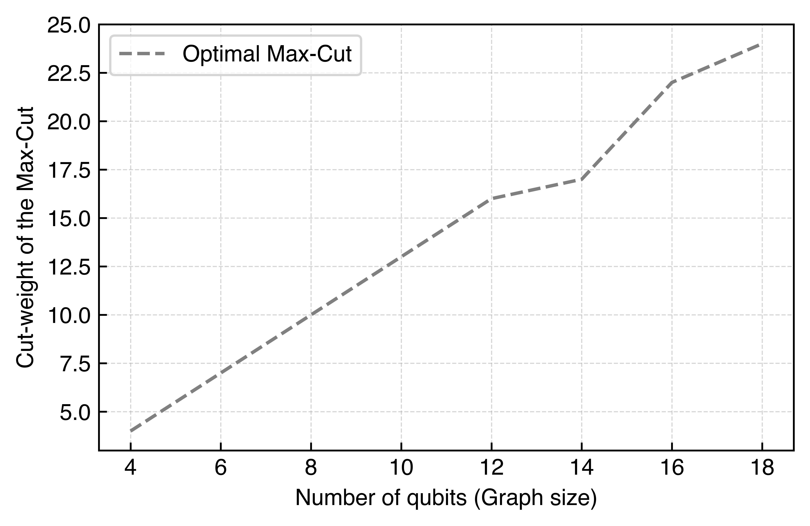
Is QAOA any good?

Slide 21
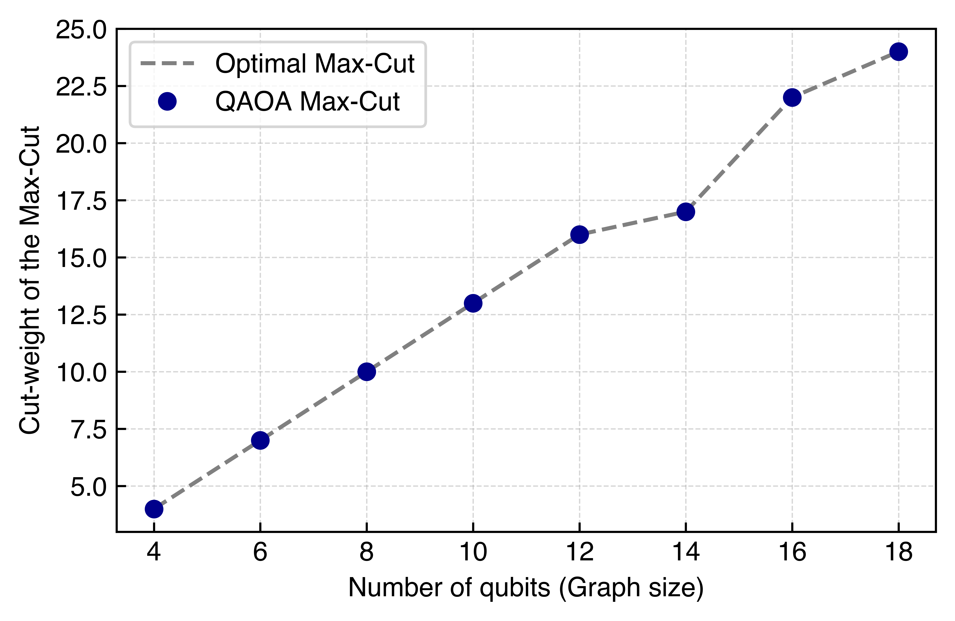
Is QAOA any good?
⇒ QAOA finds optimal cut!
⇒100% accuracy
BUT…

Slide 22
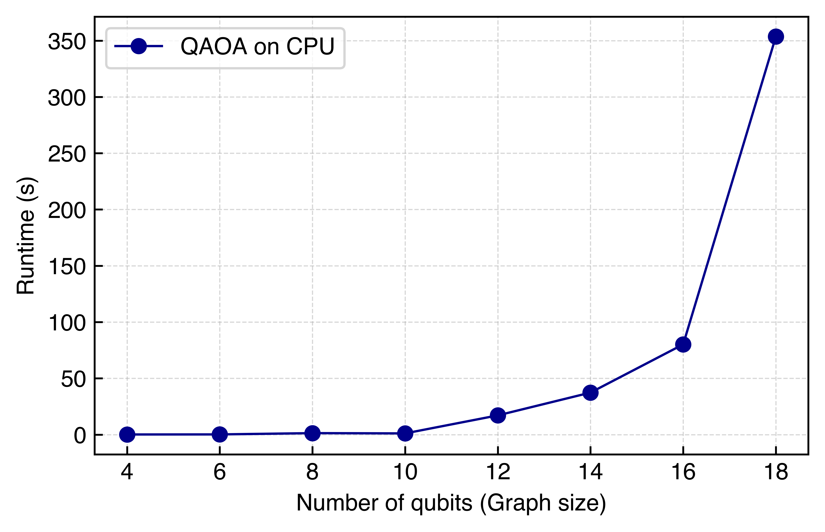
How long does it take?
⇒ (expected) exponential runtime!!
⇒NVIDIA GPUs!
Limited

Slide 23
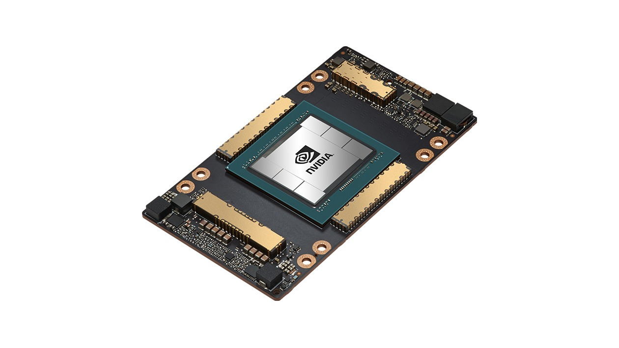
How long does it take?
A100
Industrial grade GPU!
(Pay to win)

Slide 24
How long does it take?
⇒ (expected) exponential runtime!!
⇒NVIDIA GPUs!
Limited

Slide 25
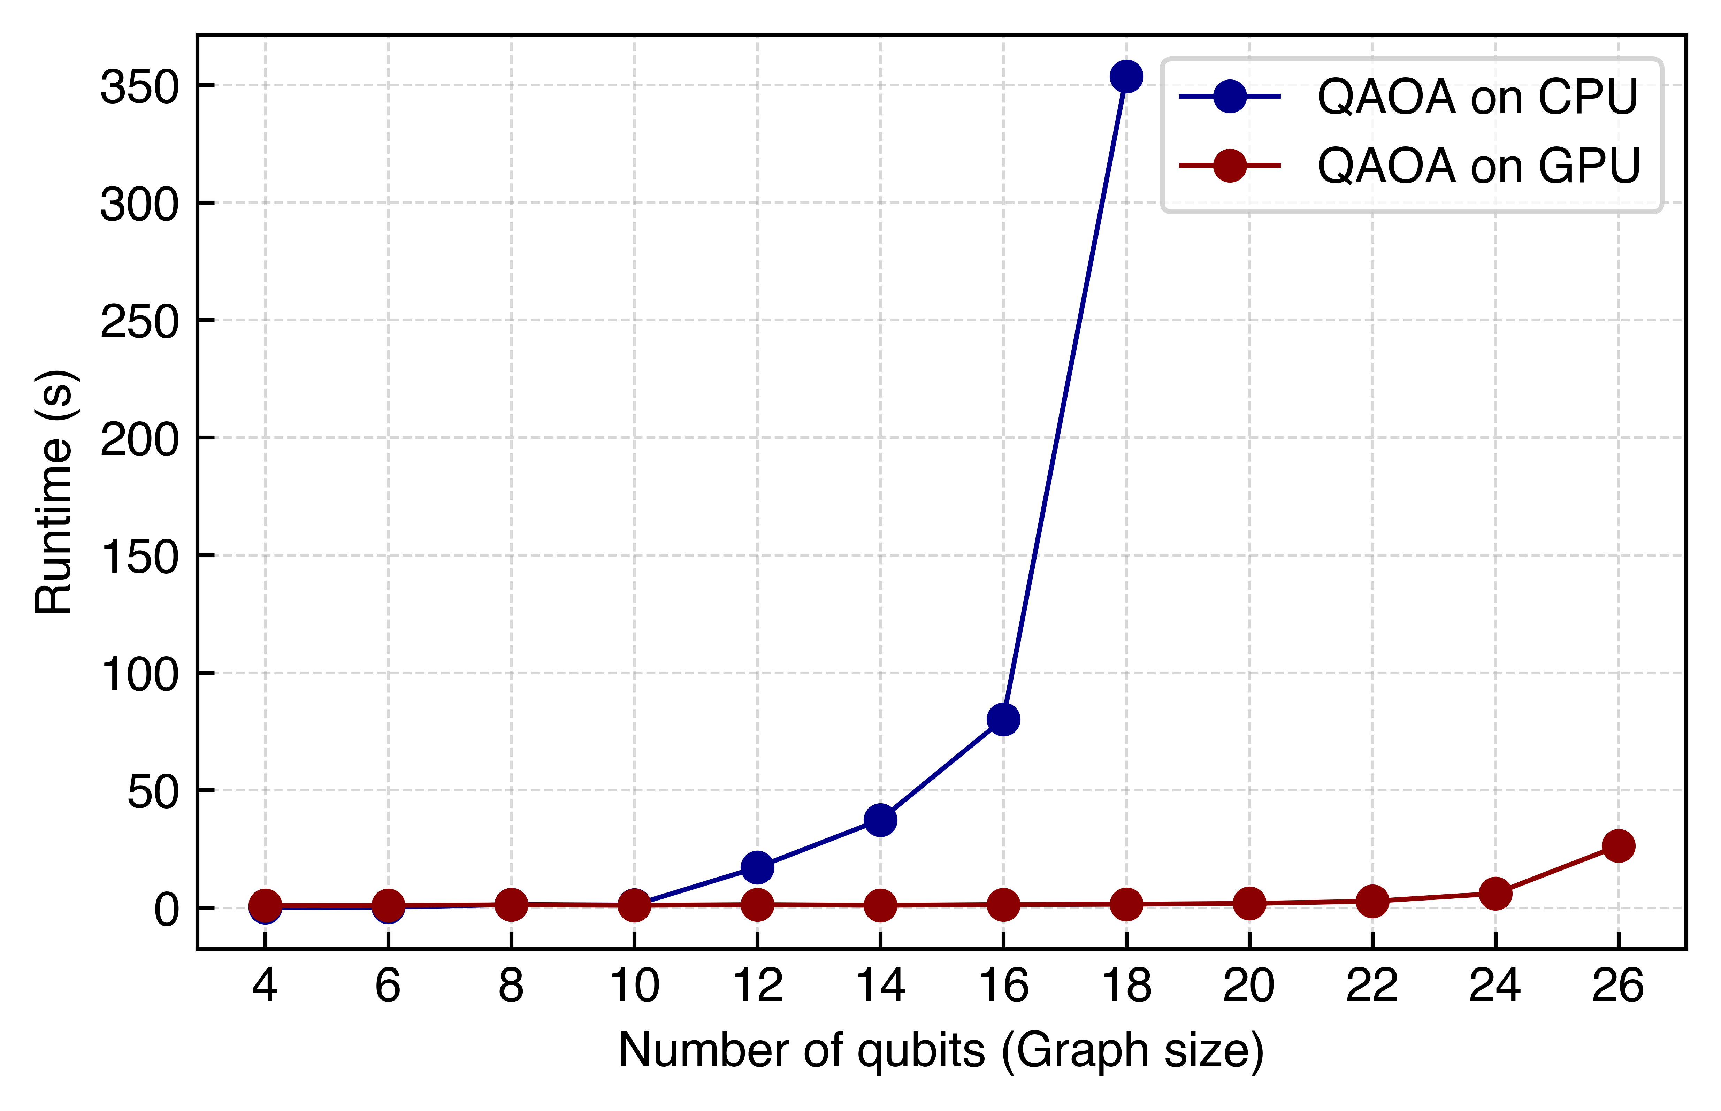
How long does it take?
260x
⇒ Still exponential BUT way flatter!
Can we go even further?
Bigger possible range

Slide 26
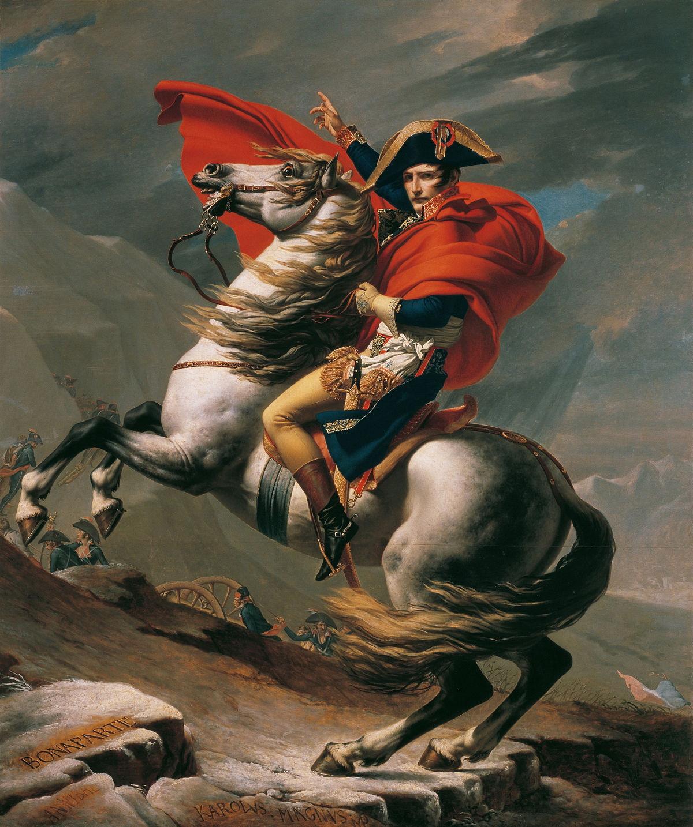
Let’s divide and conquer
Paul
Zhou et al. (2205.11762)

Slide 27
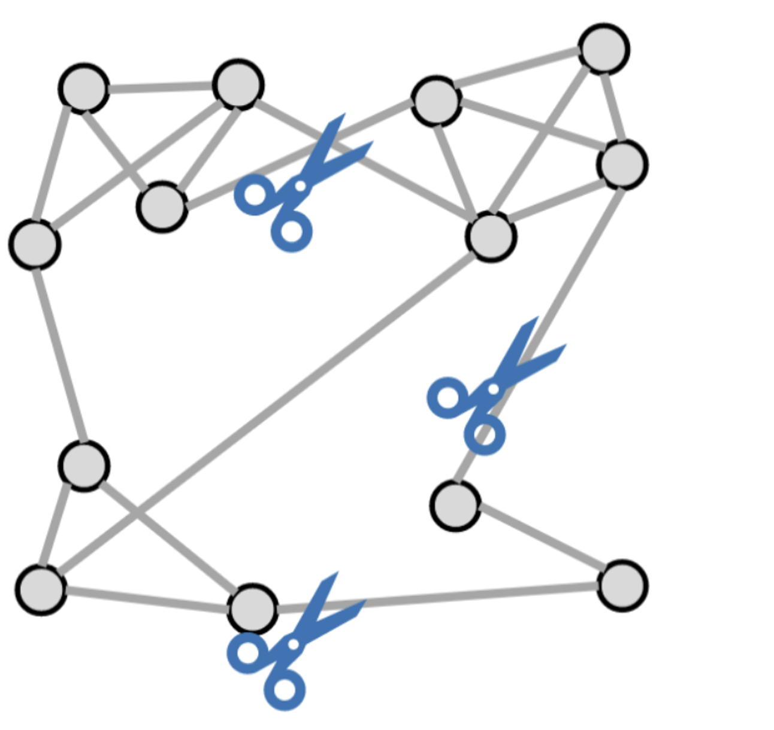
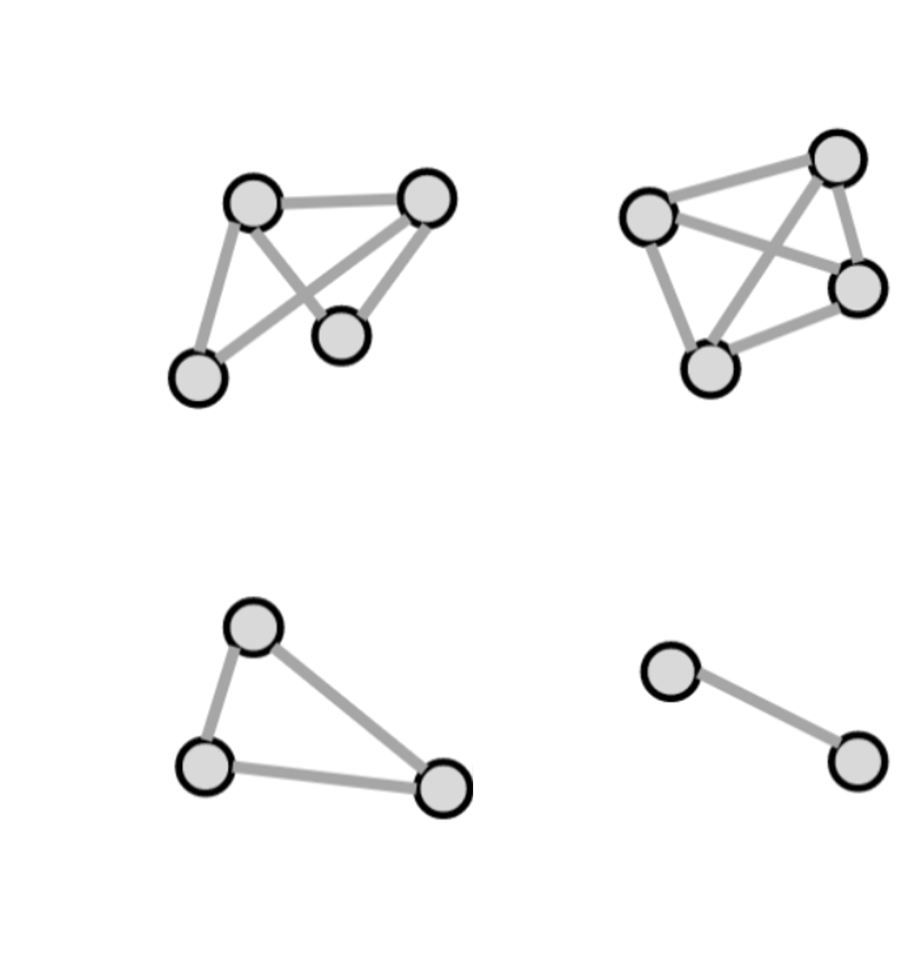
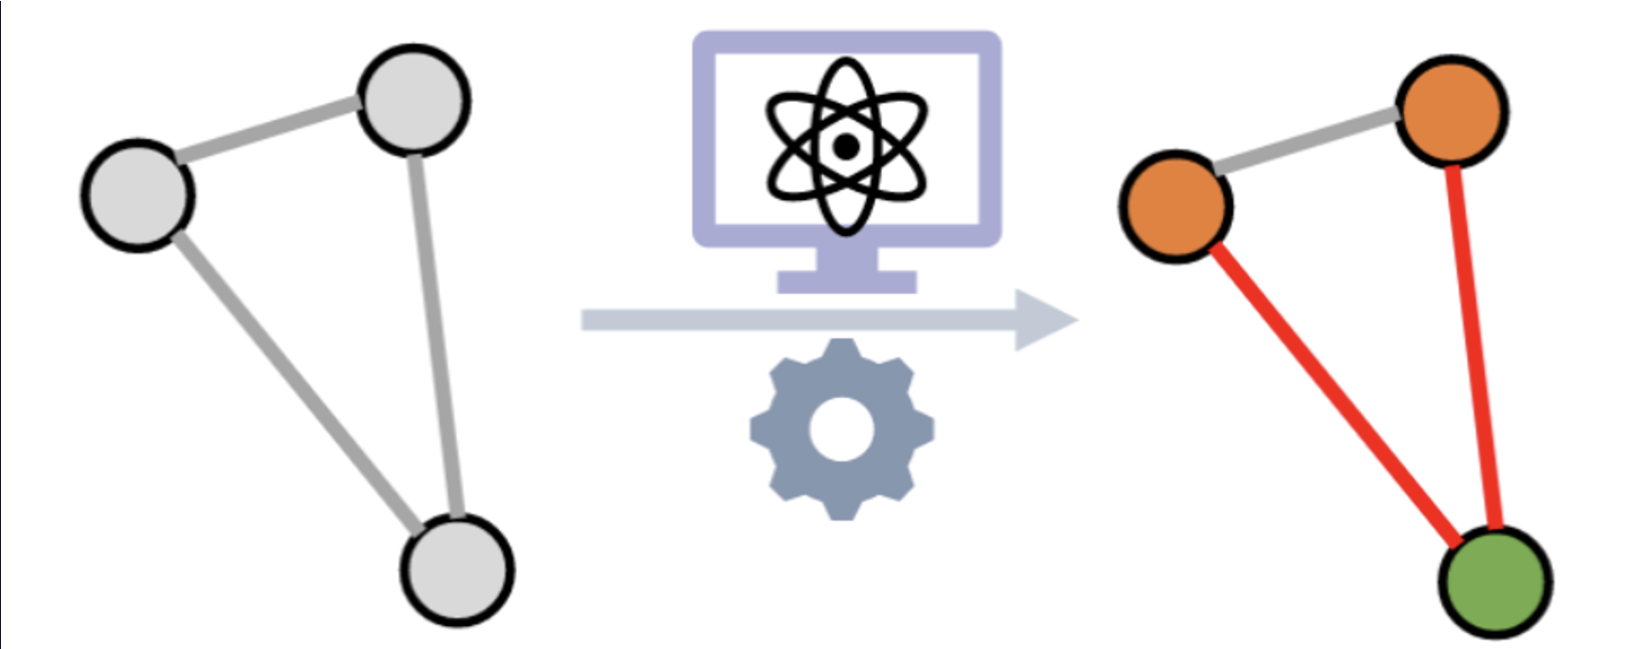
What do we divide?
And what do we conquer?
Main idea
Divide graph into subgraphs (2)
2) Solve MaxCut on subgraphs

Slide 28
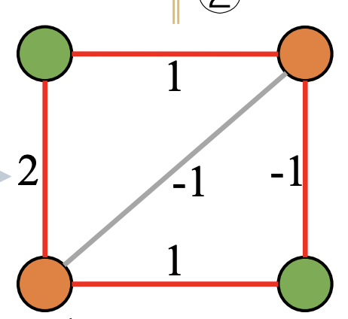
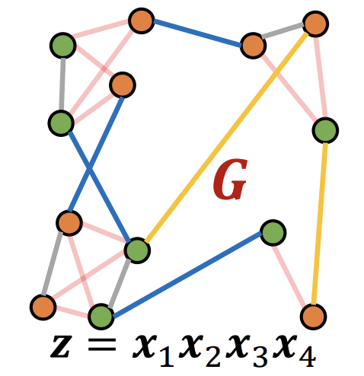
What do we divide?
And what do we conquer?
Main idea
Divide graph into subgraphs (2)
2) Solve MaxCut on subgraphs
3) Combine subgraphs as nodes
4) Last MaxCut on simple graph
⇒ Can halve the size of our graphs!

Slide 29
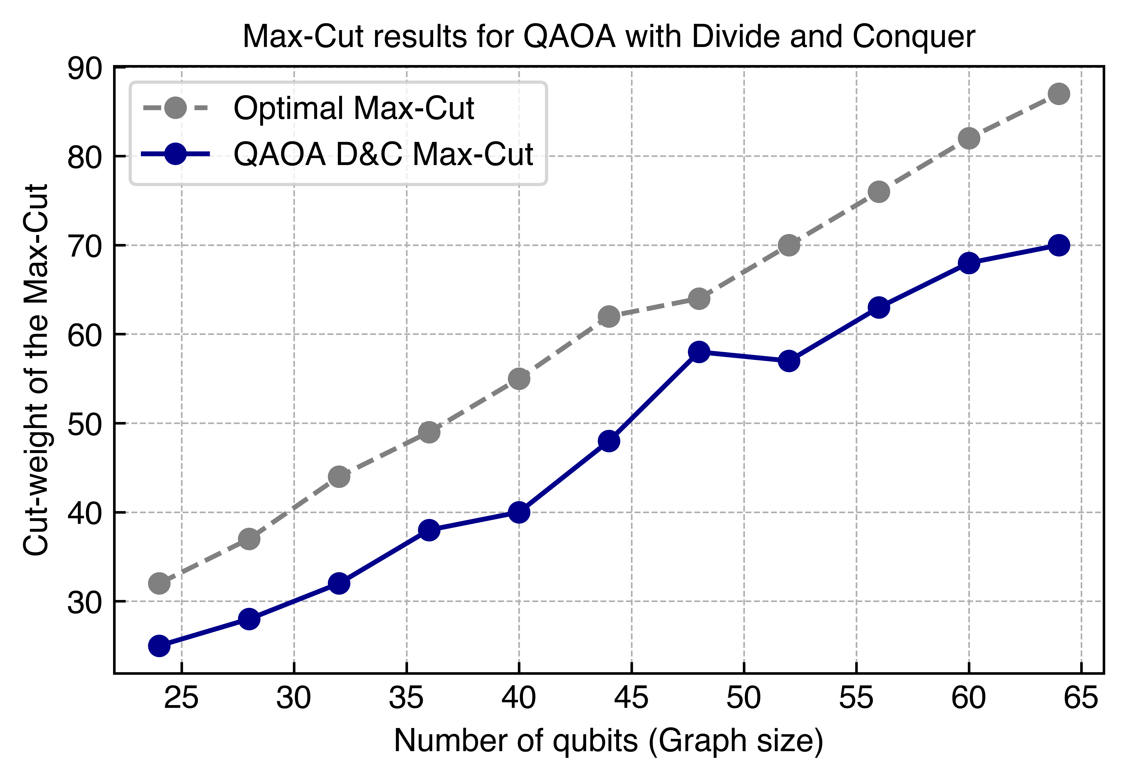
Performance of D&C
Is this any good?
⇒Lose performance (expected)
=> Still pretty close, metric?
Much more qubits are possible
(double)
=>Let’s look at the ratio!

Slide 30
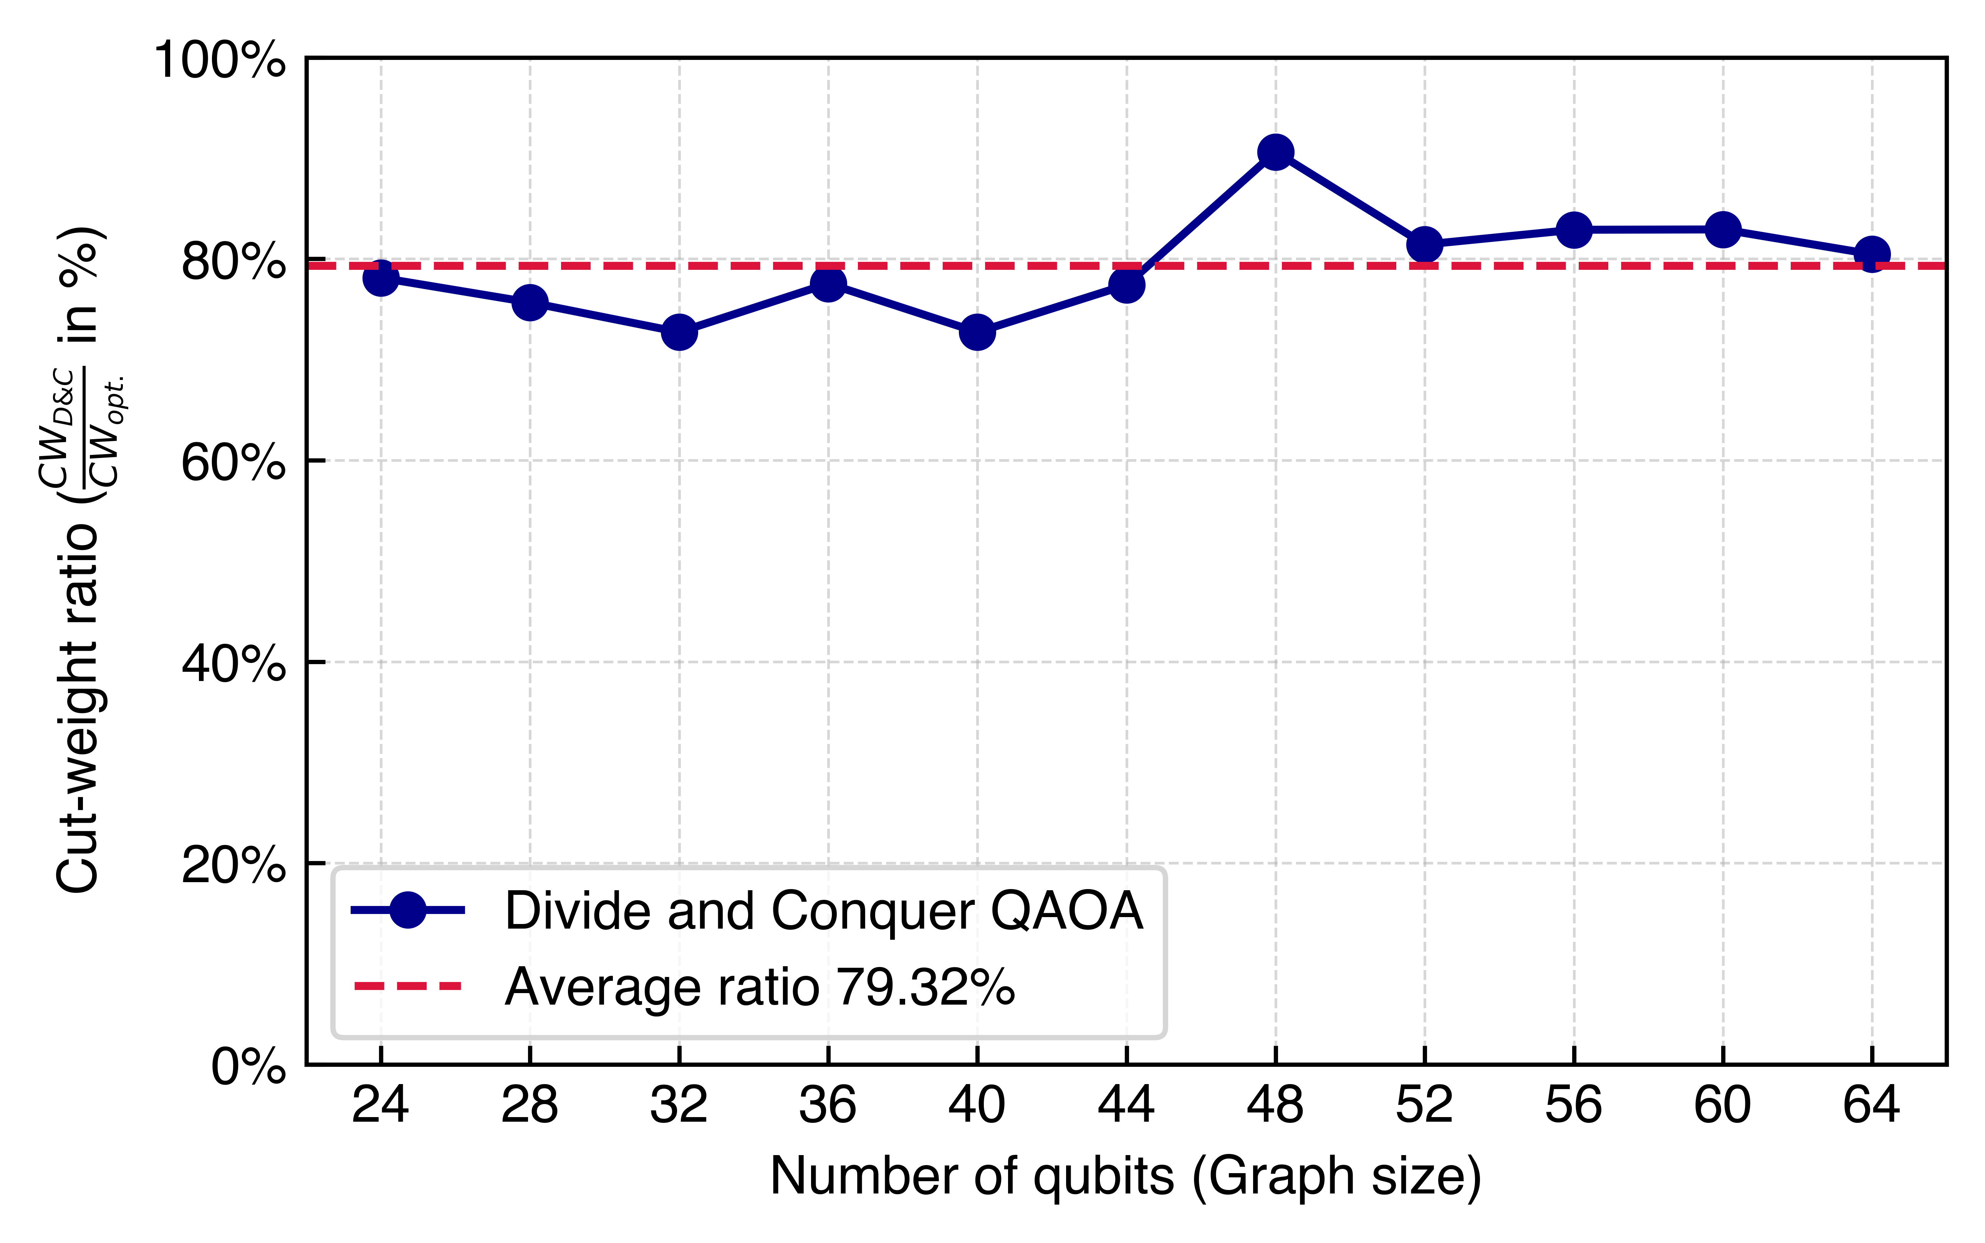
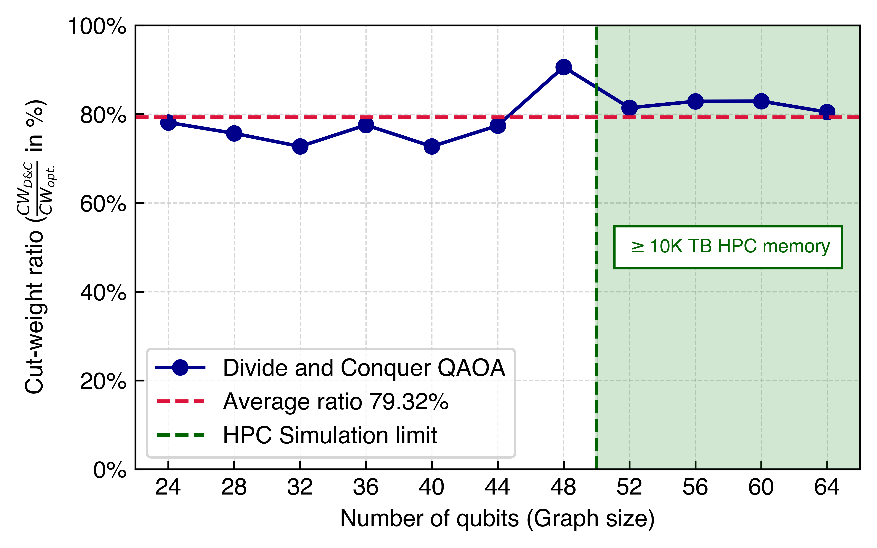
Performance of DAC
Is this any good?
=> 80% ratio!

Slide 31
Performance of DAC
Is this any good?
=> 80% ratio for not naively simulable graph sizes!

Slide 32
BACKUP Slides

Slide 33
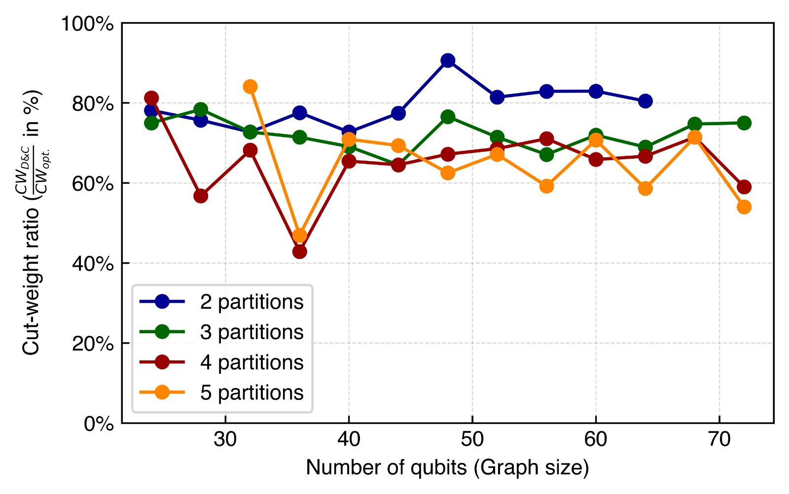
Comparison of different partitions of graphs

